Slide 1
Introduction to Dev Ops
Azure Training

Slide 2
Agenda
What is DevOps
Key Principals
Tools
Questions?

Slide 3

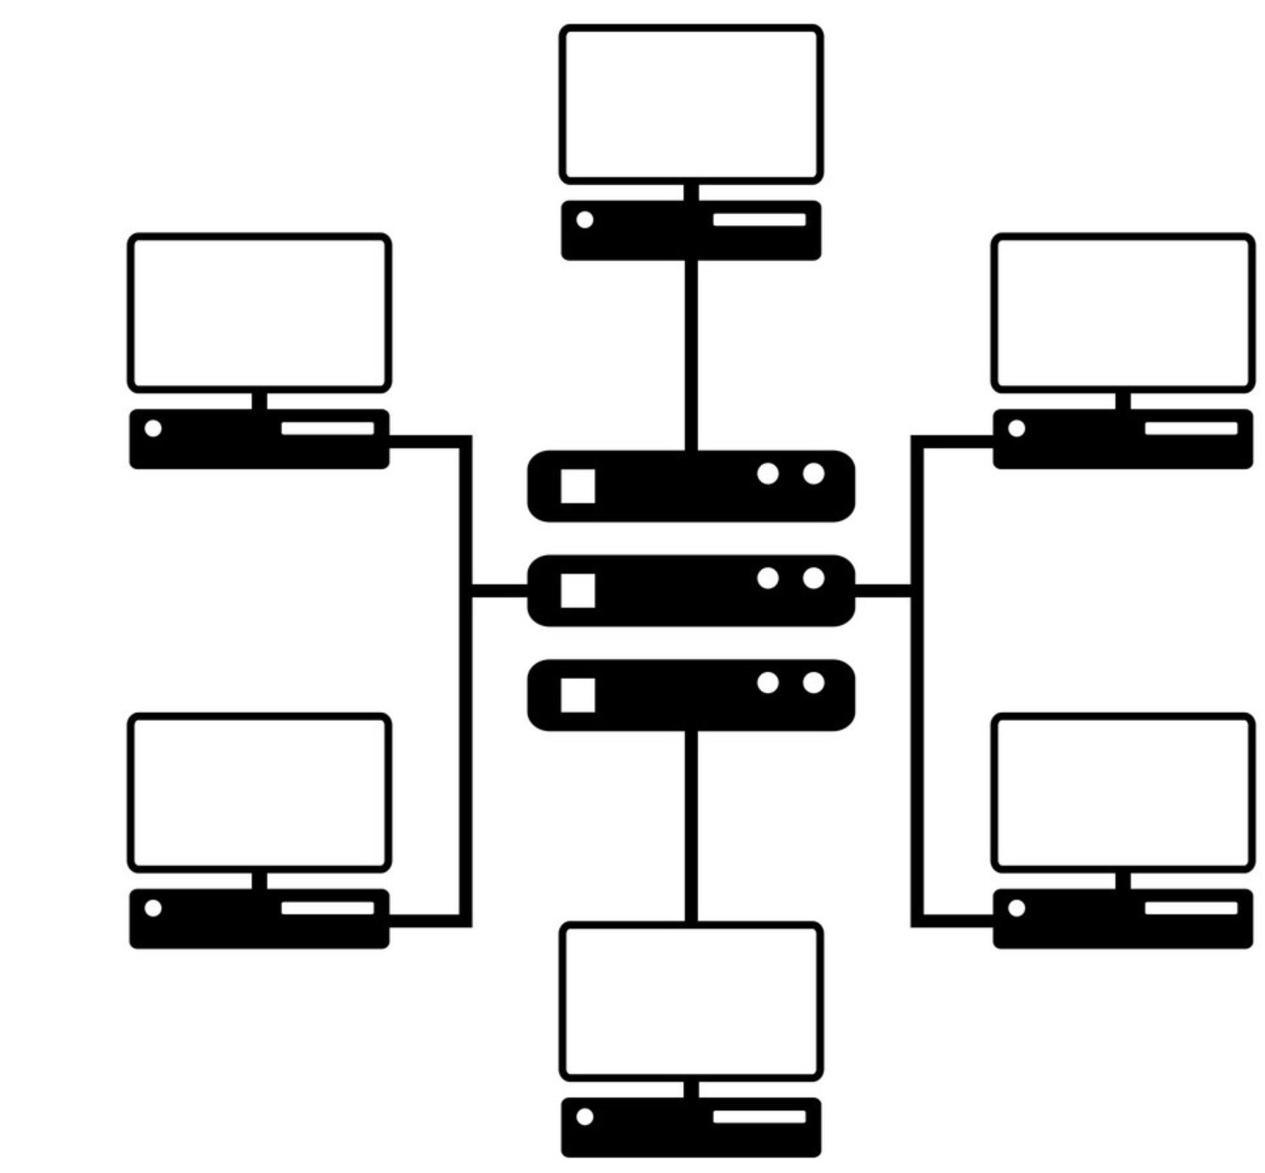
Intro to Infrastructure as a code
Problem:
Features take long time from requirement to reach end users (finished work would stack up for one big deployment on the end of the work)
Code is integrated very late in the Development Process
Lots of features deployed at once makes it difficult to test
Code becomes “hot potato” tossed between teams – Dev Team, Test Team, Operation Team and non of the teams want take the responsibility when something goes wrong
Upload ARM Templates to Repo
Define Build Pipeline
Create Release Pipeline
Assign variables to pipeline
Self-contained: Access = copy of Repo and entire codebase and history

Slide 4
Solution:
DevOps

Slide 5
Introduction to DevOps concept
DevOps – what is DevOps?
Definition: It is set of practices, principals and tools used in software development lifecycle
Origin: Has its roots from agile software development to keep up with increased velocity of the software development
Main goal: Provide value to the business in shortest possible time
Name: Development + Operations = (DevOps)
Notes:
Understanding observability: https://thenewstack.io/monitoring-vs-observability-whats-the-difference/#:~:text=Observability%20and%20monitoring%20complement%20each,monitor%20a%20system%20that's%20observable.

Slide 6
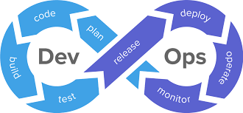
Introduction to DevOps concept
DevOps – what is DevOps?
Notes:
Understanding observability: https://thenewstack.io/monitoring-vs-observability-whats-the-difference/#:~:text=Observability%20and%20monitoring%20complement%20each,monitor%20a%20system%20that's%20observable.

Slide 7
Introduction to DevOps concept
DevOps – What are the goals
Main goal: Provide value to the business in shortest possible time
Improve deployment frequency
Integrate teams by introducing shared responsibility (usually Dev and Operations, but also Test and BA)
Reducing the lead time between creating the code and providing the features to the end users
Regular releases into production – release smaller releases that are well tested
Reduce unnecessary documentation (release notes etc.)
Documenting the requirements in this way so it is clear for dev team, can be prioritize and assign to a code change
Automation of the all process (Deployment, Testing)

Slide 8
Agenda
What is DevOps
Key Principals
Tools
Questions?

Slide 9
Introduction to DevOps concept
DevOps – Key Principles
Embrace failure
Fail Fast
No-blame culture
Learn from mistakes
Continuous improvement
Move failure as close to development as possible
Unite teams
Foster collaboration between departments
Small cross functional teams
Shared responsibilities (responsible for code running in production)
Encourage continuous improvement
Adopting agile development practices (Scrum)
Keep Management involved
Automate everything
Deployment
Testing

Slide 10
Introduction to DevOps concept
DevOps – Key Principles
Be transparent
Traceability from requirement to delivered feature
Clear requirements and acceptance criteria
Monitor
Monitor impact of the change on the solution
Monitor each piece of the development lifecycle (work efficiency)

Slide 11
Introduction to DevOps concept
Agile Development
Release (R)
R
R
Dev + Test
Dev/Test/Fix/Monitor
Dev/Test/Fix/Monitor
t
Iteration 1
Iteration 2
Iteration N
P
P+R
P
P+R
Plan (P)
Playback + Retro (P+R)
Each Iteration should have main 4 actions:
Sprint Planning on the beginning (not to overcommit work)
Retrospective on the end to learn lessons
Show to the stakeholders what was delivered
Deployment to UAT/PROD on the end with tested features
Notes:
Dev Ops can truly be adopted when using Agile development approach
Recommended SCRUM
Short Iteration (2 Weeks)

Slide 12
Agenda
What is DevOps
Key Principals
Tools
Questions?

Slide 13
Introduction to DevOps concept
DevOps – Tools and it’s requirement
Source Control (GIT, GITHUB, TFVC)
Centralised and allowing good collaboration
Least complex branching strategies
Best practices (good description, linking work items)
Good integration between work management (board), code repository and deployment pipelines
Work management (Dev Ops Boards)
Adjustable to the work team style (Scrum/Agile/Kanban)
Ability to Team Tacking progress, Team capacity and key KPI like velocity and burndown chart
Good Integration with Source Control and Test Plans

Slide 14
Introduction to DevOps concept
DevOps – Tools and it’s requirement
Infrastructure as Code (ARM Templates, Terraform, Bicep)
Easy to implement and change
Allow reuse via parameters and modules
Easy to learn (pick what you already know)
Build pipelines & Release Pipelines (DevOps Pipelines, GitHub Actions, Team City, Octopus Deploy, Jenkins)
Easy to create and change
Be reusable (via modules and parameters)
Be integrated with source control (sored in the source control)
Provide fast pace deployment for multiple environments
Allow to implement gateways and approvals for governance

Slide 15
Introduction to DevOps concept
DevOps – Tools and it’s requirement
Automated Testing Software (Pester, NUnit, XUnit)
Should be easy to implement and change
Should be reusable as much as possible
Fully automated and integrated with the pipelines

Slide 16
Agenda
What is DevOps
Key Principals
Tools
Questions?

Slide 17
Thank you

